Slide 1
Unit 7: A multivariate approach to linguistic variation Statistics for Linguists with R – A SIGIL Course
Stephanie Evert
Computational Corpus Linguistics Group FAU Erlangen-Nürnberg

Slide 2
Linguistic variation
Variation of a quantitative linguistic feature
frequency of passive, past perfect, split infinitive, …
frequency of expression, semantic field, topic, …
association strength, lexical density, productivity, …
across
languages and language varieties
regions & social strata
time (diachronic change)
individual speakers & discourses

Slide 3
Studying linguistic variation
Univariate approach
compare single feature across two or more conditions
e.g. AmE vs. BrE vs. IndE vs. … / male vs. female / etc.
corpus frequency comparison
Regression approach
predict single quantity from multiple explanatory factors
Multivariate approach
identify common patterns of variation across multiple different features ➞ correlation analysis
inductive techniques don't require pre-defined conditions
Notes:
speak first about univariate approach ➞ linguistic variation (beyond the “dimension” of interest) is often a nuisance
then about multivariate approach ➞ linguistic variation along mutliple dimensions is the object of investigation
finally, can multivariate and univariate techniques be combined for a more sophisticated analysis?

Slide 4
Variation as a nuisance parameter
Many aspects of linguistic variation are nuisance parameters in corpus linguistics
e.g. difference in frequency of passives between AmE and BrE, as well as development from 1960s to 1990s (Unit #2)
ignore other dimensions such as genre/register variation by pooling frequency data from all texts of each corpus
corpus is analyzed as a random sample of VP tokens
Consequences
variation ➞ non-randomness ➞ overestimate significance
discussed in much more detail in Unit #8

Slide 5
The multivariate approach
Different linguistic features often show similar patterns of variation
E.g. passives and nominalizations

Slide 6
The multivariate approach
Different linguistic features often show similar patterns of variation
E.g. passives and nominalizations
Such correlations can be exploited to determine major dimensions of var.

Slide 7
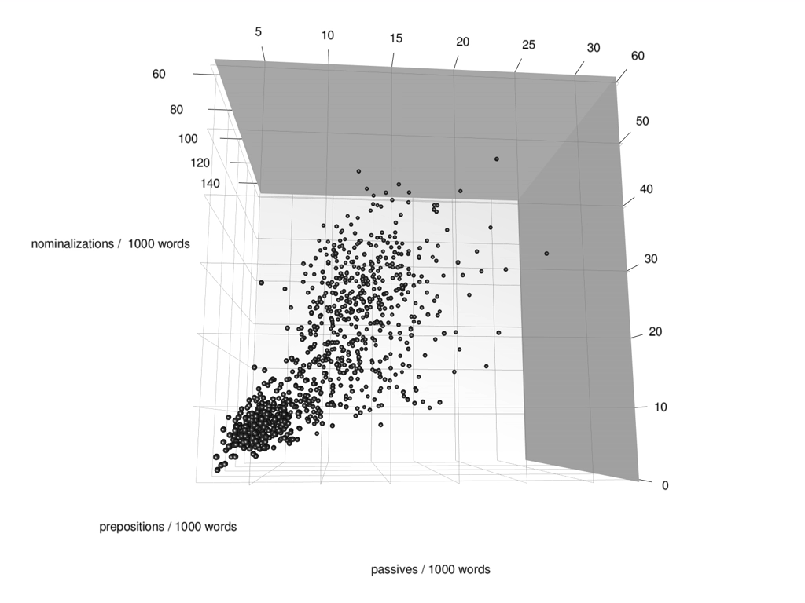
The multivariate approach
Notes:
z = prepositions
y = nominalizations
x = passives

Slide 8
The multivariate approach
Multivariate analysis exploits correlations between features in order to determine latent dimensions
interpreted as underlying “causes” of variation
An inductive, data-driven approach
no theoretical assumptions about linguistic variation and categories / sub-corpora to be compared
Pioneering work by Doug Biber (1988, 1993, 1995, …)
“multidimensional analysis” of register variation
Related approaches: correspondence analysis, distributional semantics, topic modelling, …

Slide 9
Biber's multidimensional analysis (MDA)

Slide 10
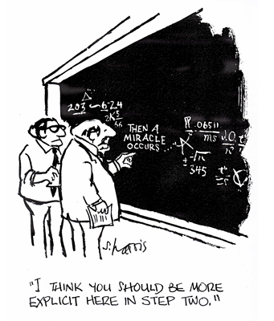
Biber's MDA
factor analysis (FA)

Slide 11
Biber's MDA

Slide 12
Pitfalls
Design bias: choice of quantitative features
Design bias: selection of text samples
Involves a miracle
not clear what quantitative patterns are captured by FA
magic number: how many factor dimensions?
Interpretation bias
arbitrary cutoff for feature weights (“loadings”)
risk of reading one's own expectations into features
More subtle patterns of variation invisible
Significance & reproducibility of results?

Slide 13
Reproducing Biber's dimensions
Sample of 923 medium-length published texts from written part of British National Corpus (BNC)
Covers 4 different text types + male/female authors
academic writing, non-academic prose, fiction, misc.
Biber features extracted automatically with Python script (Gasthaus 2007)
all frequencies normalized per 1000 words
data available in R package corpora (BNCbiber)
Factor analysis with 4 latent dimensions + varimax
seems to yield the most clearly structured analysis

Slide 14
Design bias: choice of features
correlation matrix

Slide 15
Design bias: choice of features
correlated with noun frequency
correlation matrix
correlated with verb frequency
(all feat's measured per 1000 words)

Slide 16
Design bias: choice of text samples
?
?

Slide 17
Interpretation bias
?
?
?

Slide 18
Interpretation bias

Slide 19
Variation between texts is ignored
“confidence” ellipse
(➞ significance)

Slide 20
Design bias: choice of texts (redux)
Bootstrapping

Slide 21
And there's the magic number …
3-factor analysis (instead of 4 factors)

Slide 22
Blindness to subtle patterns
But research shows that author gender can be identified with high accuracy
Koppel et al. (2003): 77.3% with function words + POS n-grams
Gasthaus (2007): 82.9% with SVM on Biber features
This dataset: 82.3% accuracy
baseline: 73.1%

Slide 23
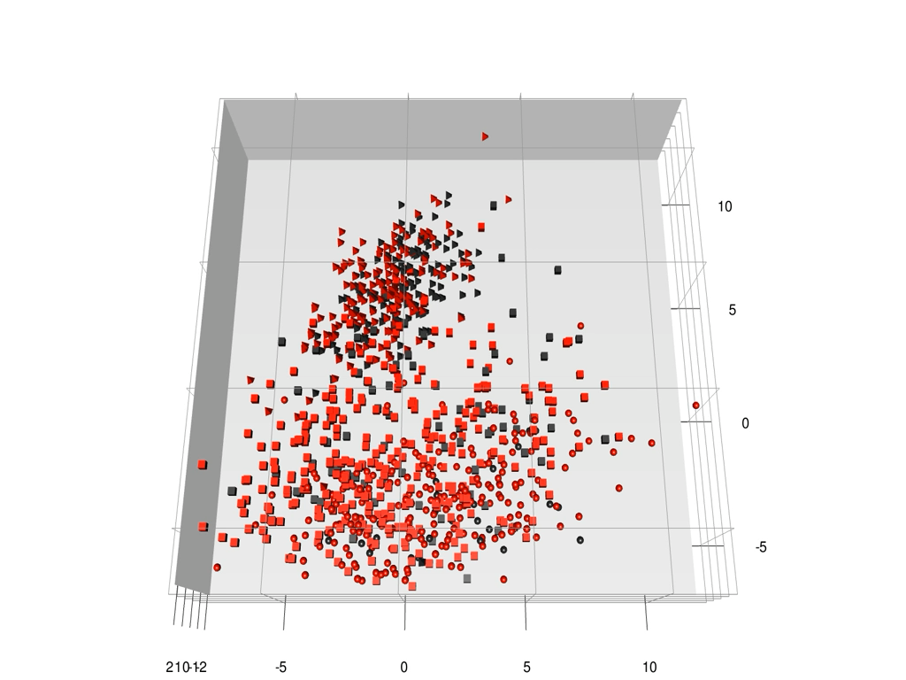
Blindness to subtle patterns

Slide 24
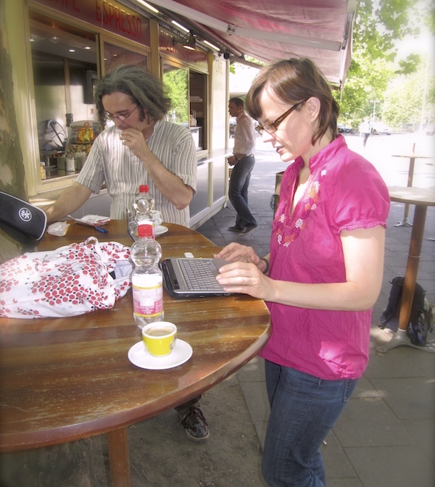
Geometric Multivariate Analysis (Diwersy, Evert & Neumann 2014; Evert & Neumann 2017; Neumann & Evert 2021)
Online supplements:
https://www.stephanie-evert.de/ PUB/EvertNeumann2017/
https://www.stephanie-evert.de/ PUB/NeumannEvert2021/

Slide 25
Geometric Multivariate Analysis (Diwersy, Evert & Neumann 2014; Evert & Neumann 2017; Neumann & Evert 2021)
Axiom: (Euclidean) distance = similarity of texts
depends crucially on theoretically motivated features
Visualization ➞ interpret geometric configuration
latent dimensions as geometric projections
orthogonal projection = perspective on data
method: principal component analysis (PCA)
Minimally supervised intervention
based on externally observable, theory-neutral information
method: linear discriminant analysis (LDA)
Bootstrapping / cross-validation to assess significance
Cautious interpretation of feature weights
Notes:
➞ NB: Biber's FA can also be seen (approximately) as perspective on Euclidean distances, but doesn't make this underlying assumption explicit

Slide 26
Case study: CroCo
genre: language-external situation + purpose
register: language-internal co-occurrence patterns of linguistic features
(Neumann 2013; Evert & Neumann 2017)
CroCo: parallel corpus English/German
English-German and German-English translation pairs
we use 298 texts from 5 different genres (excluded: instruction manuals, tourism, fiction)
28 lexico-grammatical features (Neumann 2013)
comparable between languages
inspired by SFL and translation studies
Text = point in 28-dimensional feature space
Research hypotheses: shining through (Teich 2003), prestige effect (Toury 2012)

Slide 27
Feature design: avoid “obvious” correlations
variationist perspective but for mathematical reasons
suitable unit of measurement
(not always per 1000 words!)
Notes:
➞ e.g. passive/V rather than passive/T; exclude collinear feature active/V
➞ number of finite verbs / sentence, then number of past tenses / finite verbs

Slide 28
Feature scaling: same contribution to Euclidean distances

Slide 29
Feature scaling: optional signed log transformation

Slide 30
CroCo: correlation matrix

Slide 31
Latent dimensions as perspective on data configuration
Instead of “magical” latent dimensions we focus on orthogonal projections as perspectives on the data
cf. photograph as 2D perspective on 3D object
Different perspectives highlight different aspects
Multivariate analysis ➞ choice of perspective
principal component analysis (PCA) = perspective that reflects distances between texts as accurately as possible
should reveal major dimensions of variation
advantage over factor analysis (FA): dimensionality does not have to be fixed a priori

Slide 32
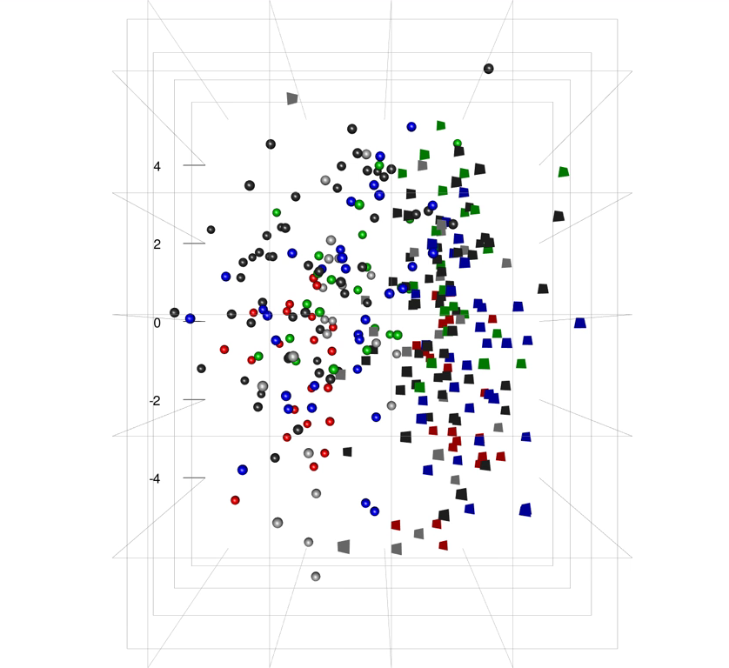
CroCo: 3-dimensional projection

Slide 33
CroCo: 4-dimensional projection

Slide 34
CroCo: genre distribution
Focus on latent dim's 1 and 3 (register variation)
Describe genre by centroid + ellipse
Comparison with Hotelling's t² test
essays vs. Web
t²=4.21, df=2/141, p=.0167 *

Slide 35
How about translationese?
PCA dim's can't sep-arate translations from original texts
62.1% accuracy on first 3 PCA dim's
But SVM machine learner can do this with >80% accuracy
RBF kernel
10-fold c.v.
Hints at shining through, but no clear-cut evidence

Slide 36
Minimally supervised LDA
Add minimal amount of supervised knowledge to find a more informative perspective
evidence for shining through hypothesis from dimension that corresponds to contrast German vs. English
supervised knowledge: language of original texts only
Linear discriminant analysis (LDA)
maximize separation between German / English originals
minimize variability within each group
classical technique related to PCA and ANOVA
Project all texts onto LDA discriminant
complemented by additional PCA dim's for visualization

Slide 37
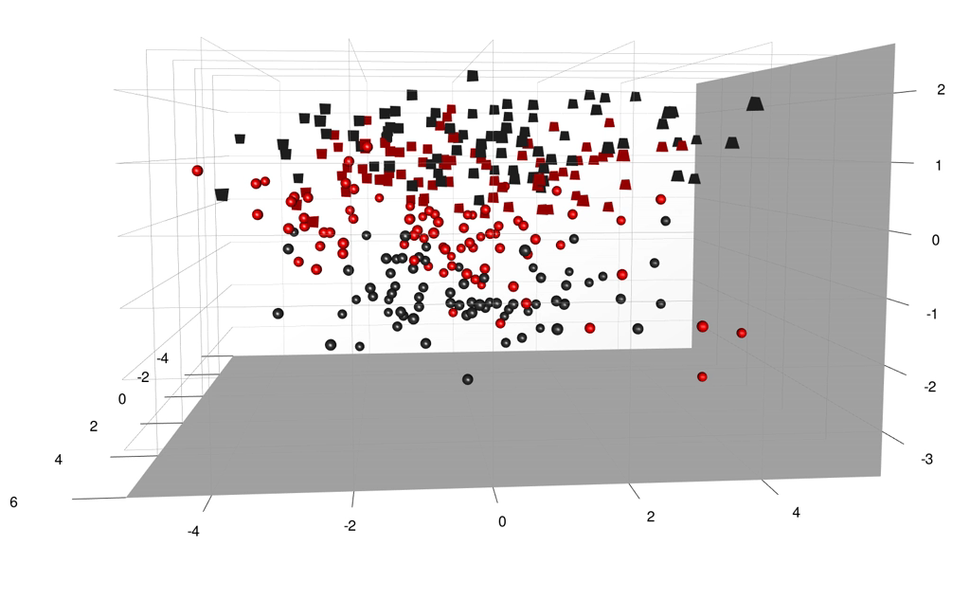
CroCo: LDA perspective
English
German

Slide 38
Discriminant for DE vs. EN confirms shining through & prestige effect
–1.1
+1.3
acc = 76.8%
German
English

Slide 39
LDA significance: bootstrapping / cross-validation
LDA is a supervised ML technique ➞ overtrained?
Would we find the same discriminant if we trained on a different set of texts?
Verification with bootstrap resampling or 10-fold cross-validation
LDA trained on 90% of data
discriminant axis shows “wobble” of approx. 10°
Discriminant scores from c.v. (10% test data per fold)
CV fold #4
CV fold #5
CV fold #2
CV fold #1
CV fold #3

Slide 40
Cross-validated discriminant
LDA on full data set
10-fold cross-validation
–1.1
+1.3
acc = 76.8%
acc = 73.8%
German
English

Slide 41
Interpreting discriminant features
Notes:
• large weights on sentence length (token/S), TTR, modal.adv, prepositions, themes, subordination, imperatives
• but: large weight doesn't necessarily imply feature is characteristic of DE/EN; positive / negative weight not directly interpretable

Slide 42
Interpreting discriminant features

Slide 43
Interpreting discriminant features
Notes:
• little effect from imperatives (➞ outliers) snd TTR; themes not characteristic except for obj theme

Slide 44
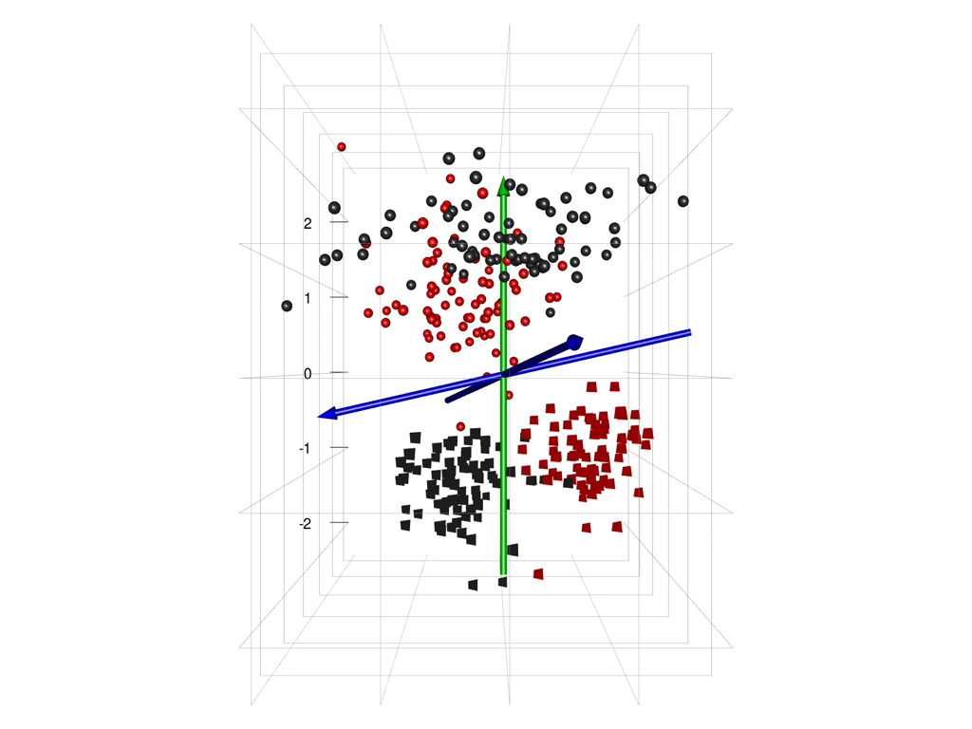
Unravelling translationese
German
LDA for trans vs. orig
in each language
English

Slide 45
Case study 2: French regional varieties
(Diwersy, Evert & Neumann 2014)
Lexical differences in regional varieties of French
Two nation-wide newspapers each from 6 countries
Cameroon, France, Ivory Coast, Morocco, Senegal, Tunisia
two consecutive volumes from each newspaper
total size approx. 14.5 million tokens
Text samples = one week each
Features: frequencies of shared colligations
colligation = lemma-function pairs
must occur in all subcorpora with f ≥ 100

Slide 46
FRV: poor choice of features
PCA not excluding country-specific words as features: perfect separation
Design bias results in a completely uninteresting model
FA not applicable: features >> texts

Slide 47
FRV: PCA dimensions
Using only shared words as features, PCA no longer reveals any patterns
(just a few outliers)
Use LDA to find a meaningful per-spective, based on newspaper source
Country would presume regional varieties exist!

Slide 48
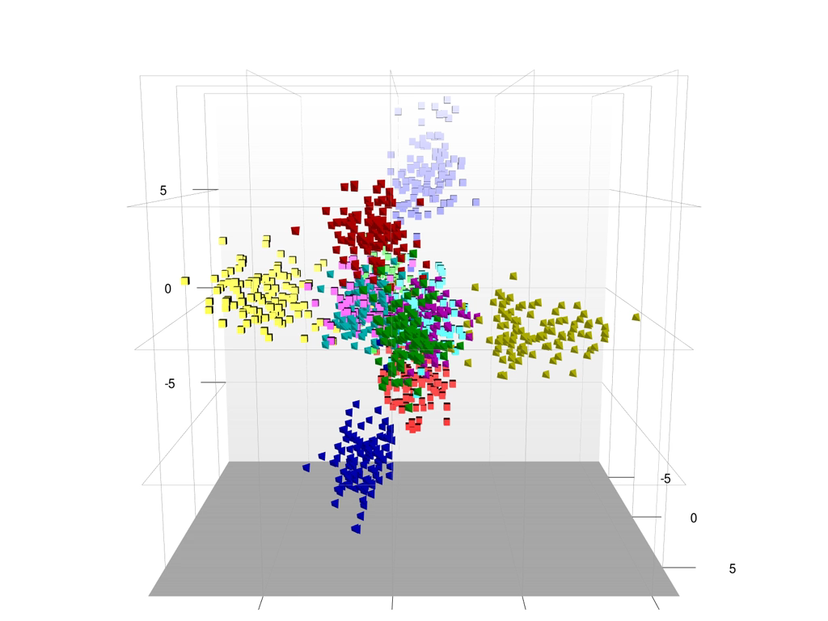
FRV: LDA dimensions (newspapers)

Slide 49
FRV: LDA dimensions (newspapers)

Slide 50
FRV: discriminant axes

Slide 51
References
Biber, D. (1988). Variation Across Speech and Writing. Cambridge University Press, Cambridge.
Diwersy, S.; Evert, S.; Neumann, s. (2014). A weakly supervised multivariate approach to the study of language variation. In B. Szmrecsanyi & B. Wälchli (eds.), Aggregating Dialectology, Typology, and Register Analysis. Linguistic Variation in Text and Speech. De Gruyter, Berlin.
Evert, S. & Neumann, S. (2017). The impact of translation direction on the characteristics of translated texts: a multivariate analysis for English and German. In G. De Sutter, M.-A. Lefer & I. Delaere (eds.), Empirical Translation Studies. New Theoretical and Methodological Traditions (TiLSM 300), pages 47–80. Mouton de Gruyter, Berlin.
Gasthaus, J. (2007). Prototype-Based Relevance Learning for Genre Classification. B.Sc. thesis, Universität Osnabrück, Institute of Cognitive Science.
Koppel, M.; Argamon, S.; Shimoni, A. R. (2003). Automatically categorizing written texts by author gender. Literary and Linguistic Computing, 17(4), 401–412.
Neumann, S. (2013). Contrastive Register Variation. A Quantitative Approach to the Comparison of English and German. de Gruyter Mouton, Berlin.
Neumann, S. & Evert, S. (2021). A register variation perspective on varieties of English. In E. Seoane & D. Biber (eds.), Corpus based approaches to register variation. Benjamins, Amsterdam.
Teich, E. (2003). Cross-linguistic variation in system and text. A methodology for the investigation of translations and comparable texts. Berlin: Mouton de Gruyter.
Toury, G. (2012). Descriptive Translation Studies – and beyond: Revised edition. 2nd ed. Amsterdam: John Benjamins.

